Slide 1
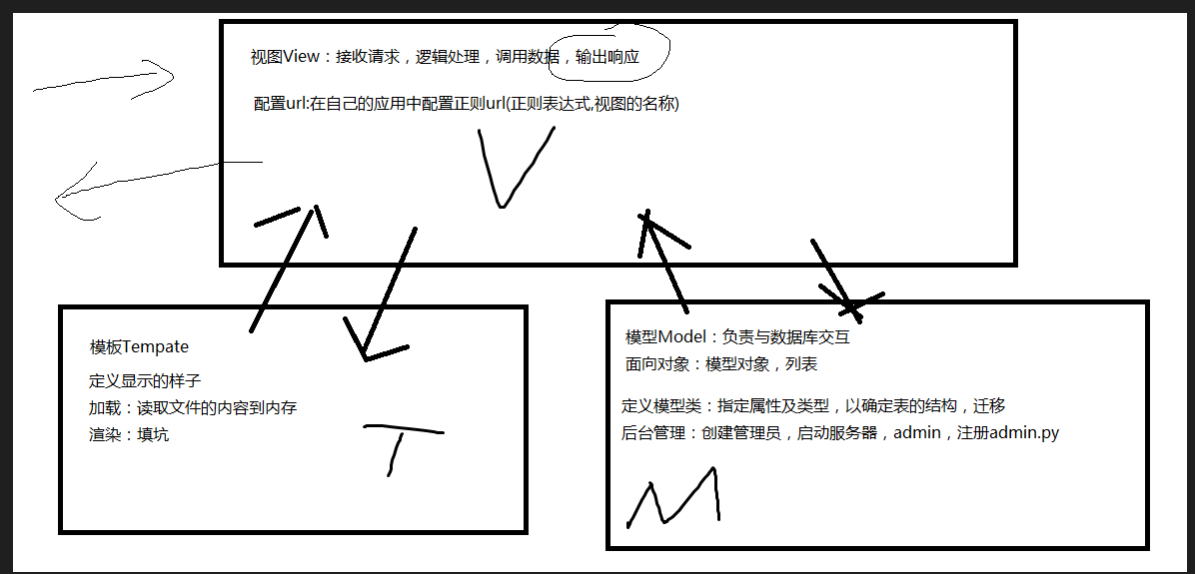
Django 的 MVT關係

Slide 2
Project (test1)
- manage.py
test1
- settings.py
- urls.py
- wsgi.py
templates
booktest
- index.html
app (booktest)
- admin.py
migrations
- models.py
- views.py
- 001_initial.py
- urls.py
- tests.py

